Slide 1

Weather Model
Group H
Dongwei Fu, Joyce Yang, Jun Zhang
4/7/2020

Slide 2
Overview of the Model and Workflow
Processing of Observation data
For KCMI hourly data, sum up the hourly precipitation for each day to get daily precipitation data
Replace the precipitation data in the KCMI daily files with daily precip calculated from hourly data
Other variables (tmax, tmin and wmax) used from daily files directly
Process the KCMI hourly from 6UTC up to 0UTC (not included) prior to the forecast period (shifted a day to better reflect real-world wx-challenge situation), resample to daily on min, mean, max, and sum.
Processing of GFS data
For GFS surface/profile data, resampled to daily on min, mean, max, and sum.
Replaced 9999/-9999 values with NaN, dropped NaN rows.
Unify the units for variables in Obs and GFS data.

Slide 3
Model Improvement
Selection of features
Correlation between variables
Feature importance
Manually going through and changing different combinations, taking features in/out
Tuning hyperparameters
Number of estimators
Maximum number of features

Slide 4
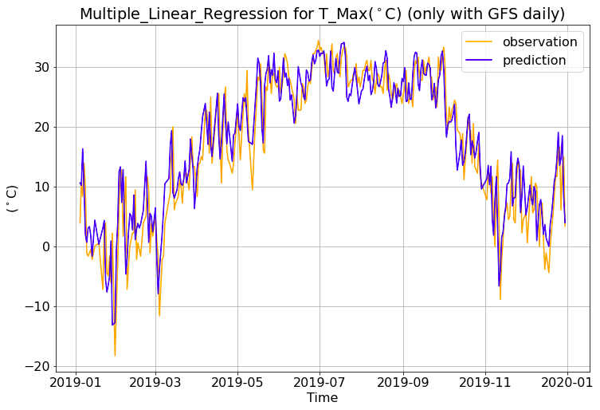
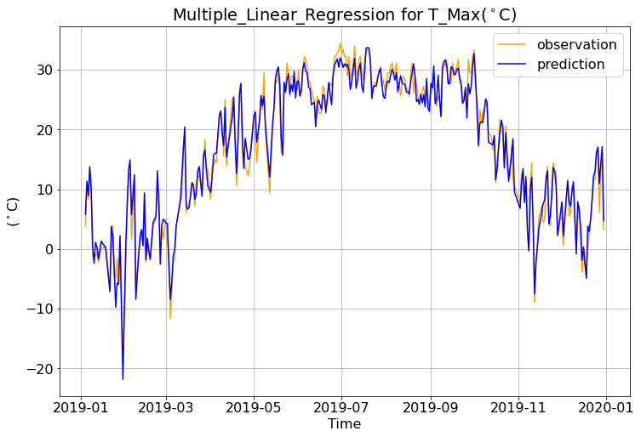
Tmax - MLR
GFS daily only
The Explained Variance: 0.87
The Mean Absolute Error: 3.29 degrees celsius
The Median Absolute Error: 2.52 degrees celsius
The Root Mean Square Error: 4.27 degrees celsius
['TMAX_GFS', 'TMIN_GFS', 'WMAX_GFS', 'RTOT_GFS']
GFS daily + vertical + surface + hourly Obs
The Explained Variance: 0.98
The Mean Absolute Error: 1.31 degrees celsius
The Median Absolute Error: 1.10 degrees celsius
The Root Mean Square Error: 1.70 degrees celsius
[all predictors in our dataframe]

Slide 5
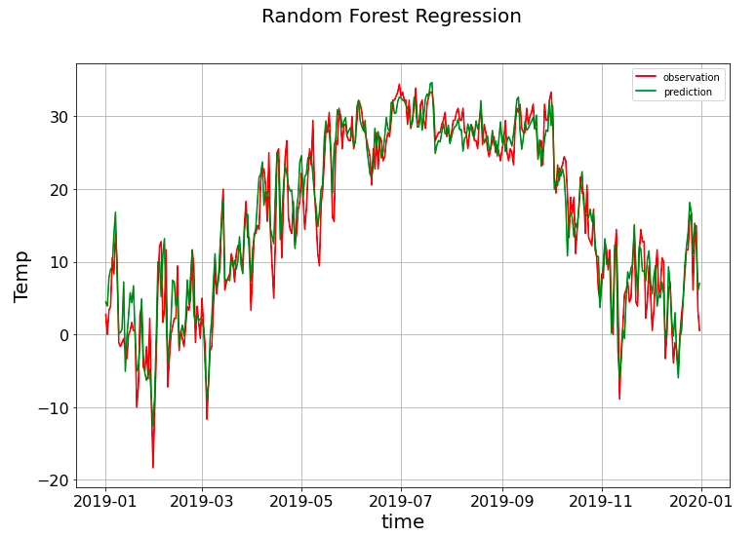
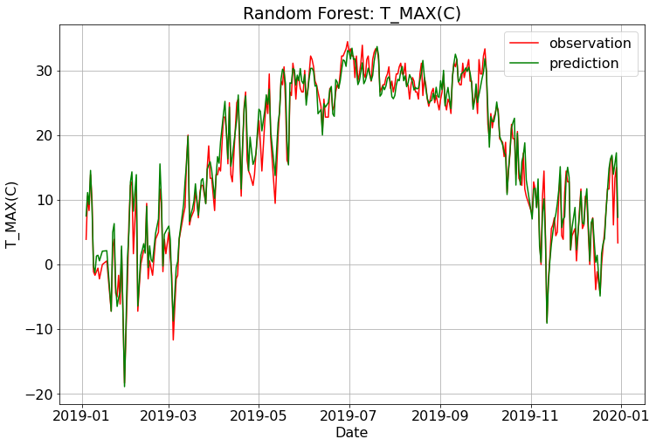
Tmax - RF
GFS daily + vertical + surface + hourly Obs
# of trees = 1000 Max features = 2
Coefficient of determination: 0.97
The Mean Absolute Error: 1.41 degrees celsius
The Median Absolute Error: 1.08 degrees celsius
The Root Mean Square Error: 1.90 degrees celsius
['TMAX_GFS', 'TMIN_GFS', 'TMPC_max', 'TMPC_925_min',
'TMPC_850_min', 'DWPC_925_max', 'DWPC_925_mean',
'tmpc_max']
GFS daily only
The Explained Variance: 0.93
The Mean Absolute Error: 2.32 degrees celsius
The Median Absolute Error: 1.76 degrees celsius
The Root Mean Square Error: 3.05 degrees celsius
['TMAX_GFS', 'TMIN_GFS', 'WMAX_GFS', 'RTOT_GFS']

Slide 6
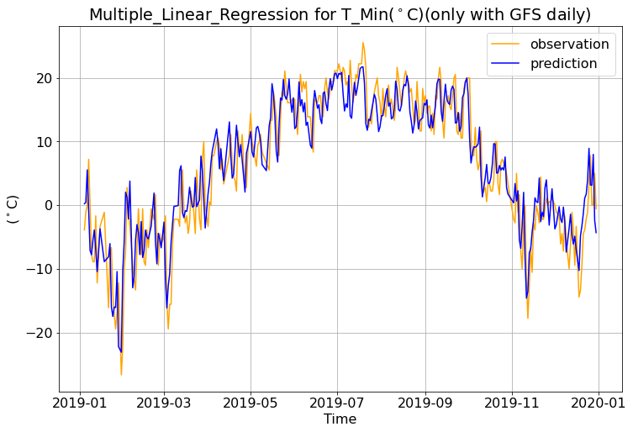
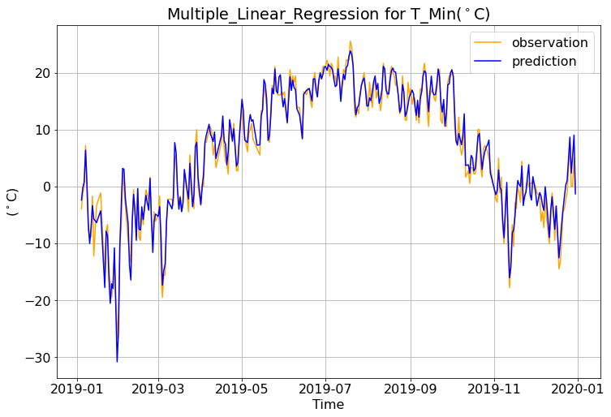
Tmin - MLR
GFS daily only
The Explained Variance: 0.86
The Mean Absolute Error: 3.24 degrees celsius
The Median Absolute Error: 2.82 degrees celsius
The Root Mean Square Error: 4.08 degrees celsius
['TMAX_GFS', 'TMIN_GFS', 'WMAX_GFS', 'RTOT_GFS']
GFS daily + vertical + surface + hourly Obs
The Explained Variance: 0.97
The Mean Absolute Error: 1.37 degrees celsius
The Median Absolute Error: 1.16 degrees celsius
The Root Mean Square Error: 1.73 degrees celsius
[all predictors in our dataframe]

Slide 7
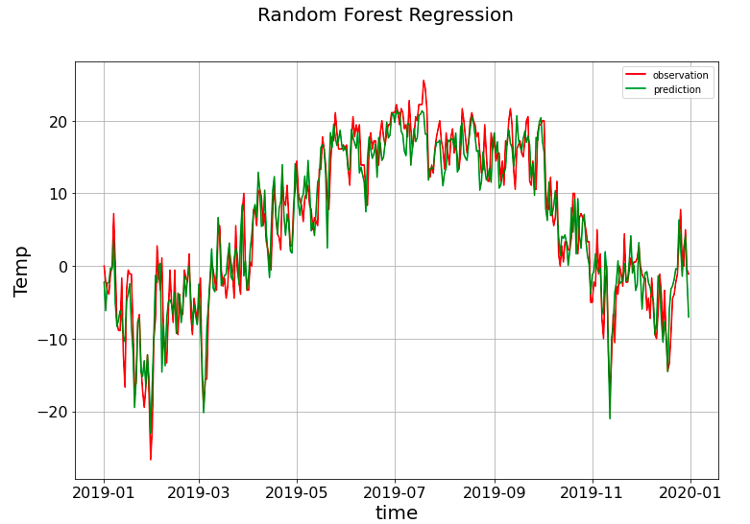
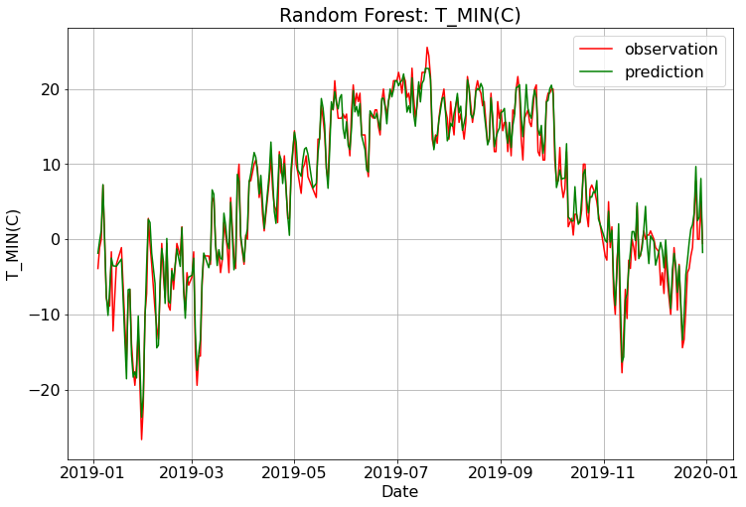
Tmin - RF
GFS daily + vertical + surface + hourly Obs
# of trees = 1000 Max features = 5
Coefficient of determination: 0.97
The Mean Absolute Error: 1.32 degrees celsius
The Median Absolute Error: 1.11 degrees celsius
The Root Mean Square Error: 1.72 degrees celsius
['TMAX_GFS', 'TMIN_GFS', 'TMPC_min','DWPC_max','TMPC_max', 'TMPC_925_min','TMPC_500_min','TMPC_700_min', 'TMPC_850_min', 'DWPC_925_min','DWPC_925_mean', 'tmpc_min','tmpc_max']
GFS daily only
The Explained Variance: 0.92
The Mean Absolute Error: 2.36 degrees celsius
The Median Absolute Error: 1.81 degrees celsius
The Root Mean Square Error: 3.10 degrees celsius
['TMAX_GFS', 'TMIN_GFS', 'WMAX_GFS', 'RTOT_GFS']

Slide 8
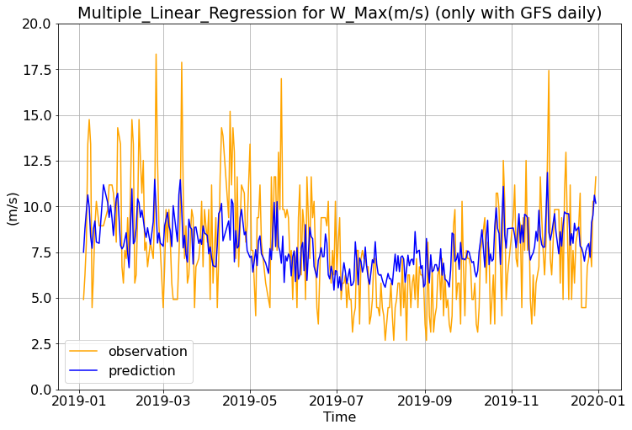
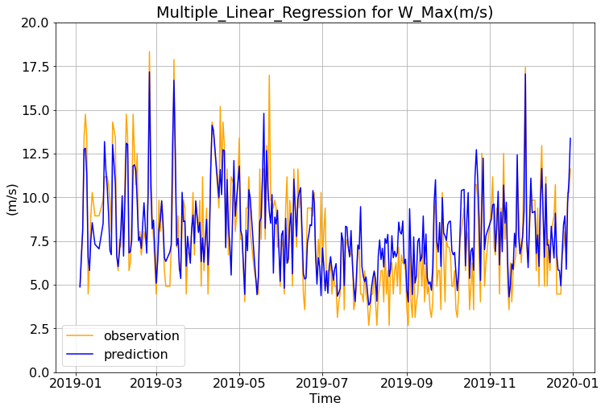
Wmax - MLR
GFS daily only
The Explained Variance: 0.22
The Mean Absolute Error: 2.11 m/s
The Median Absolute Error: 1.86 m/s
The Root Mean Square Error: 2.64 m/s
['TMAX_GFS', 'TMIN_GFS', 'WMAX_GFS', 'RTOT_GFS']
GFS daily + vertical + surface + hourly Obs
The Explained Variance: 0.71
The Mean Absolute Error: 1.24 m/s
The Median Absolute Error: 1.07 m/s
The Root Mean Square Error: 1.59 m/s
['WSPD_max','WSPD_total','WSPD_mean','WSPD_min','UWND_850_max','UWND_700_max','UWND_925_max','UWND_max','UWND_850_total','UWND_850_mean','UWND_700_total','UWND_700_mean','WMAX','UWND_500_max','VWND_500_max','wspd_max']

Slide 9
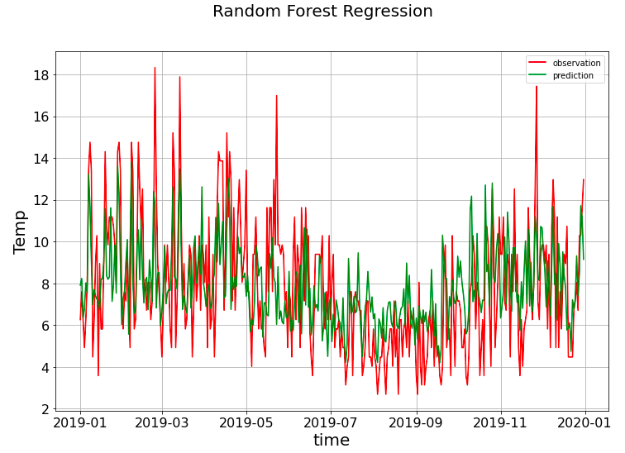
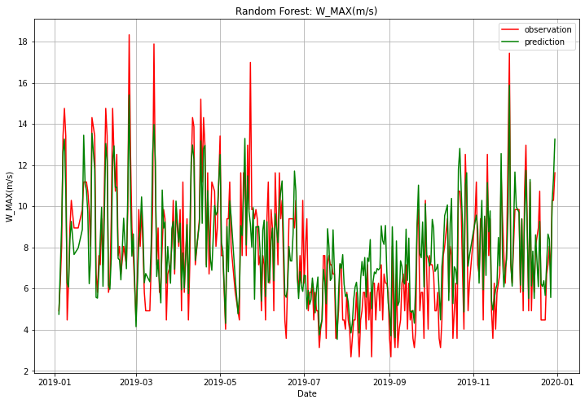
Wmax - RF
GFS daily + vertical + surface + hourly Obs
# of trees = 1000 Max features = 2
Coefficient of determination: 0.72
The Mean Absolute Error: 1.23 m/s
The Median Absolute Error: 1.02 m/s
The Root Mean Square Error: 1.57 m/s
['WMAX', 'UWND_max', 'WSPD_max', 'WSPD_mean', 'HGHT_500_min', 'HGHT_700_min', 'UWND_850_mean']
GFS daily only
The Explained Variance: 0.33
The Mean Absolute Error: 1.97
The Median Absolute Error: 1.68
The Root Mean Square Error: 2.47 m/s
['TMAX_GFS', 'TMIN_GFS', 'WMAX_GFS', 'RTOT_GFS']

Slide 10
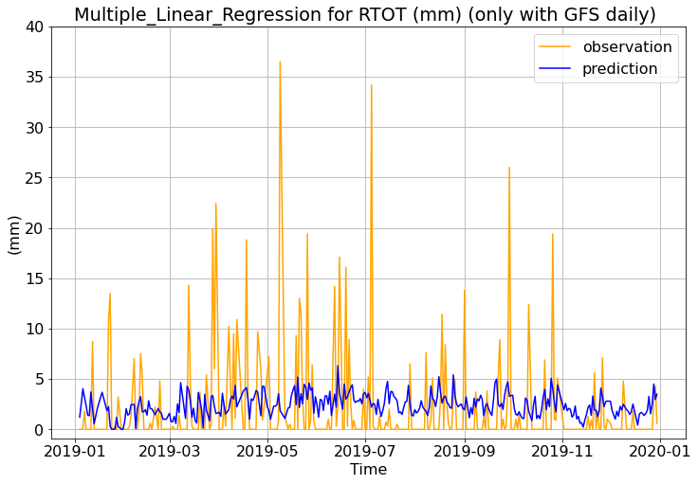
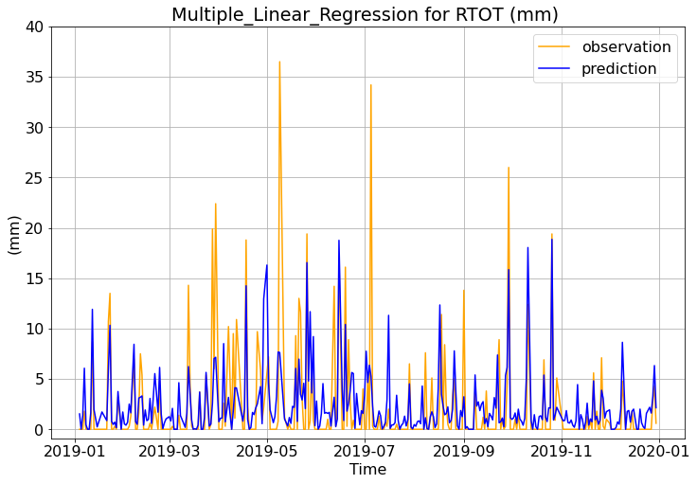
Precip - MLR
GFS daily only
The Explained Variance: -0.01
The Mean Absolute Error: 3.08 mm
The Median Absolute Error: 2.13 mm
The Root Mean Square Error: 4.87 mm
['TMAX_GFS', 'TMIN_GFS', 'WMAX_GFS', 'RTOT_GFS']
GFS daily + vertical + surface + hourly Obs
The Explained Variance: 0.37
The Mean Absolute Error: 2.09 mm
The Median Absolute Error: 1.08 mm
The Root Mean Square Error: 3.87 mm
['PRCP_Sfc_total','PRCP_Sfc_max','HCLD_Sfc_mean',
'VWND_700_max','VWND_500_max','UWND_500_mean']

Slide 11
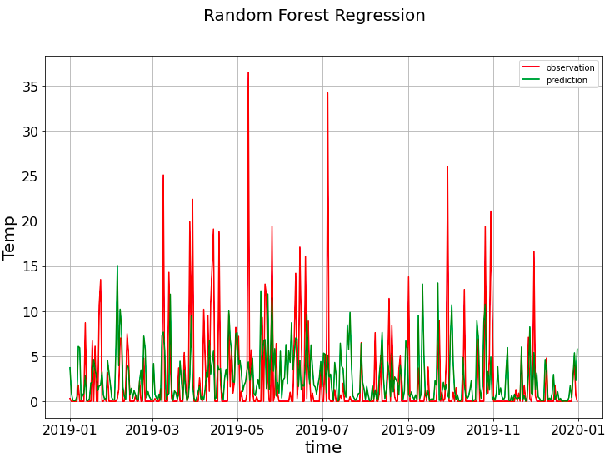
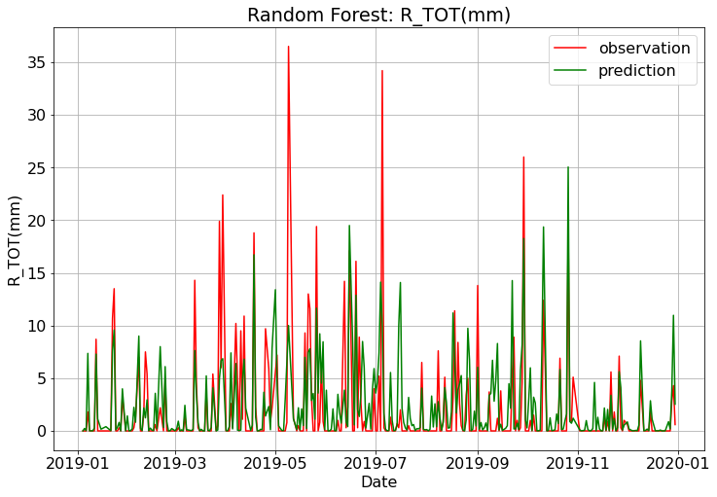
Precip - RF
GFS daily only
GFS daily + vertical + surface + hourly Obs
# of trees = 1000 Max features = 1
Coefficient of determination: 0.34
The Mean Absolute Error: 1.93 mm
The Median Absolute Error: 0.48 mm
The Root Mean Square Error: 3.78 mm
['PRCP_max', 'PRCP_mean','DWPC_700_max', 'DWPC_500_min', 'VWND_500_max']
The Explained Variance: -0.01
The Mean Absolute Error: 2.91 mm
The Median Absolute Error: 1.26 mm
The Root Mean Square Error: 5.12 mm
['TMAX_GFS', 'TMIN_GFS', 'WMAX_GFS', 'RTOT_GFS']

Slide 12
Thank You

